Slide 1
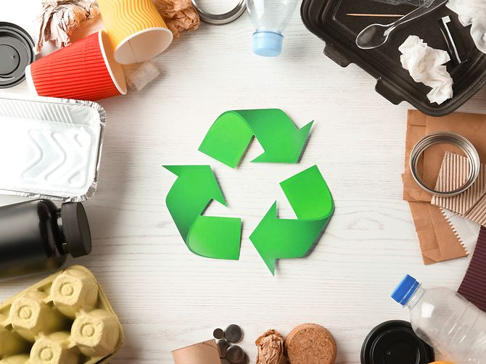
IMPLEMENTING STRATEGY

Slide 2
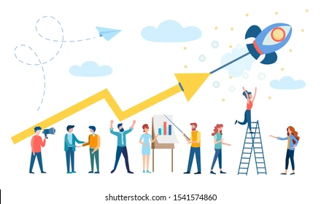
OVERVIEW OF THE COMPANY
Very is a fashion retail company of UK, it business progress established as well known brand among customers
Operational activity has been operated through online and offline process that cover each business process
Revenue has been generated in last financial year around £1,535.6m (very.co.uk, 2022
Customer growth by B2C segment is customers increased 12.4% that indicate future business growth possibilities
Group revenue grew 13 percent to a record 2.32 billion pounds That indicate use got potential in future
Notes:
Very is a fashion retail company which has established in the UK and operates business through online and offline retail stores. Revenue growth in the last financial years established is huge potential for the future basis operations. Growth of the customer segment has identified 12.4% that could be considered as sustainable growth in business. Business operation of this industry has provided potentiality in future, where consumption of plastic heating issues to continue business operations. All the process of business of activity Very improves product quality through decision making approach. The UK online retailer reported a third consecutive year of record profits in its financial year ending June 30, 2015, with profits up 78% indicating operational growth of this organisation.

Slide 3
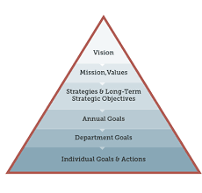
EXPLANATION OF CURRENT STRATEGIC STATEMENTS
Improvisation of product quality by adding a new recycling element improves environment quality.
Reduce consumption of plastic in operational activity to ensure less pollution to society
Improvisation of profitability by approaching less consumption of plastic elements, which ensure quality improvise productivity along with profitability
Expected result by using plastic Very would be able to save 25% of cost in productivity. Organisation would be able to manage the tax expenditure by less consumption of plastic (Flury, and Narayan, 2021)
Notes:
Strategic statement of this organisation is oriented with plastic consumption and profitability growth, where implementation of procedures regarding recycling or reuse plastic for more productivity. Non disposable plastics have become issued for this organisation where using those plastics for gain productivity would be an effective decision for organisational productivity. Reducing consumption of plastic around 45% this organisation would become effective to making sufficient profit for organisational growth. Reusing plastic to make fashionable products for customers reduces pollution that is going to deliver better opportunities for this organisation. Operational activities would be improved to reuse the plastic for productivity and gain more profit in organisational development.

Slide 4
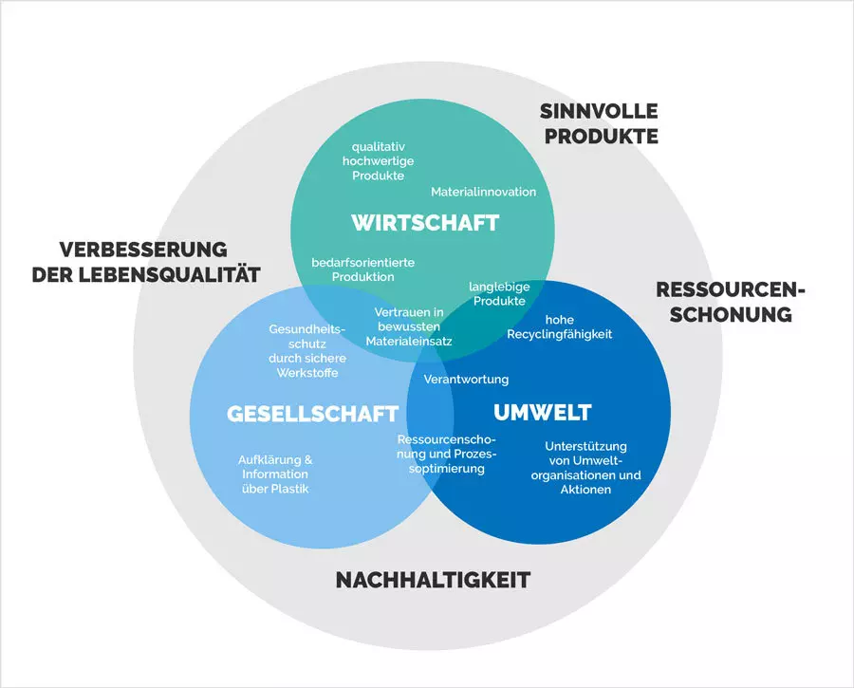
Mission
Employee productivity within the next three years is going to help revenue enhancement. This positive steps of this organisation established better image among customers (Van Rensburg et al. 2020)
Reduce use of plastic in operational activity would going to help profitable and production all cost of the organisation
Recycling of plastic wood going to employwise waste management activity in this organisation and also delivered profitability management
Operational growth would be possible by improvisation of Cost Management policies that need to be implemented within six months
Productivity and growth would be effective to gain operational activity of Very because of reducing consumption of plastic
Notes:
Organisational mission is dependent on kind business operation along with future prospect of business growth. According to the current state of plastic pollution, organisations are going to change their view towards consumption of plastic. Initial stage reducing plastic could not be the possible solution, their reuse of plastic for production going to make profitable steps. Model using operational growth by reducing cost of plastic this organisation is going to make financial flexibility for business expansion. Utilisation of existing resources of this organisation cost consumption policy regarding plastic going to deliver a positive impact on profitability.

Slide 5
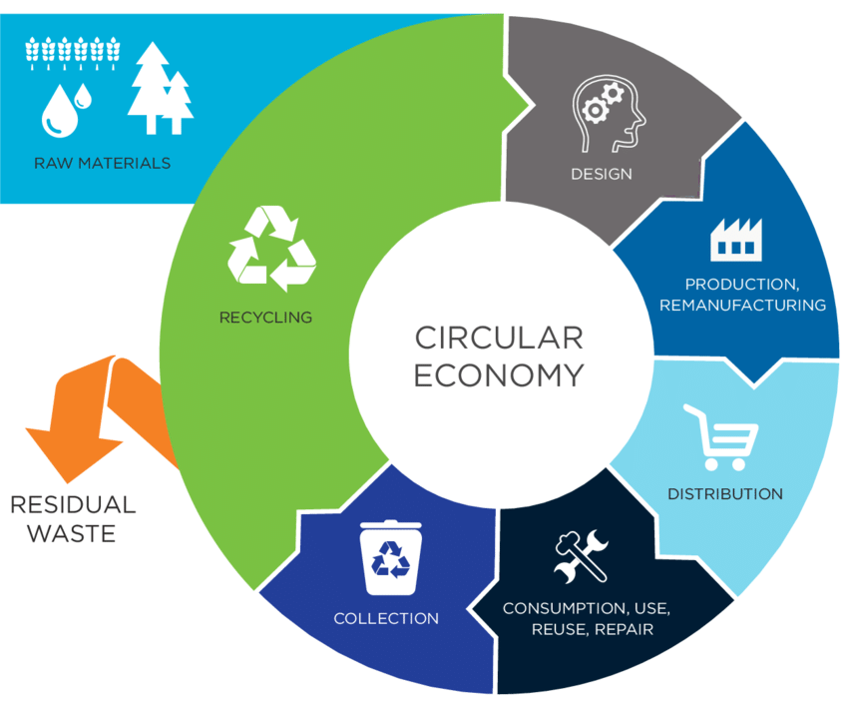
VISION
Adopting new technologies to reduce plastic would going to change fashion industry in next few years
Allocating financial resources would improve the quality of products and gain profitability by reducing the cost of production.
Using productivity growth to reduce average cost of production going to help organisation profitability and productivity to improvise productivity of organisational productivity (Serrano-Ruiz et al. 2021)
Research allocation for low productivity growth Very identify 35% cost has been consumed for plastic use where reducing use of plastic might help to gain advantage in competitive market
Notes:
Vision of Very is identified by productivity and profitability growth where anything of consumption of plastic policy in operation devaluation to create profitability. Organisational productivity would be Effective to improve Productivity by reducing cost of product along with input device operational activity. Allocated financial resources for production would be evaluated through more productivity in organisational activities that would be possible to reduce cost consumption regarding plastic use. Improvisation of organisational benefit, Process of productivity would be possible through gain profit in operational activities by recycling plastic for production of fashion products.

Slide 6
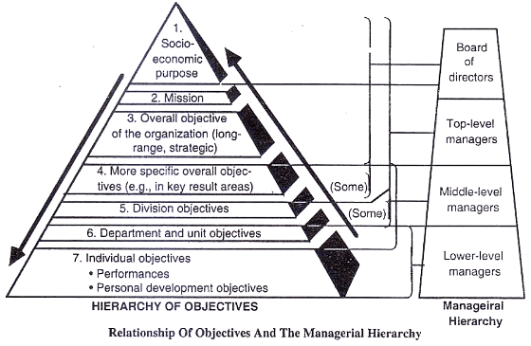
OBJECTIVES
Identify growth potential of Very by reducing use of plastic input activity on marketing.
Requirement of resources would be possible by managing and distribution of financial resource as per requirement where using of plastics for production of fashion products delivered profitability (Napper and Thompson, 2020)
Operational activities in Very would be effective by minimising cost consumption in productivity
This positive step toward production would be effective for this organisation to gain competitive advantage to gain profitability in next few years
Utilisation of financial resource ultimate gain of production Very would able to meet financial expectation
Notes:
Operational activities in Very would be effective by minimising cost consumption in productivity. Based on Environment analysis this organisation faced legal issues for over using of plastics and also affected the brand image of the company. This positive step toward production would be effective for this organisation to gain competitive advantage to gain profitability in next few years. Utilisation of financial resources ultimate gain of production Very would be able to meet financial expectation. Allocated financial resources for production would be evaluated through more productivity in organisational activities that would be possible to reduce cost consumption regarding plastic use for operational growth.

Slide 7
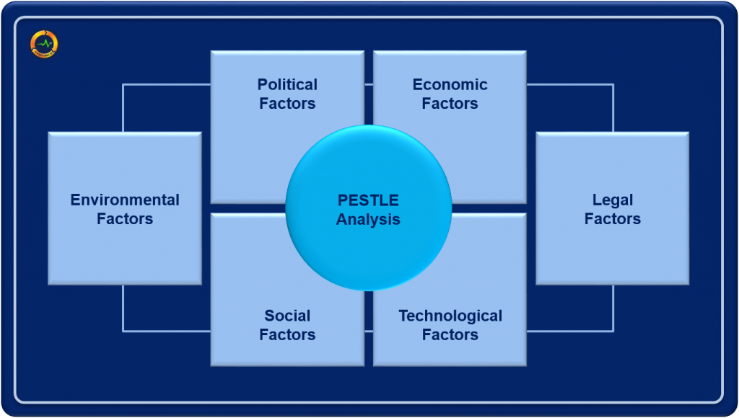
ENVIRONMENTAL ANALYSIS
Political aspect of Very has faced challenges how to using plastic for production and marketing
Using of substitute of plastic for production and marketing increase average cost of products reduce growth possibilities popularity
Brand image of Very has been affected by using of excessive plastic material as waste material that going to be increased profitability (Zhang et al. 2021)
Implementation of technology regarding reuse of plastics going to increase brand image among customers Qi et al.
Legal position of this organisation has been disrupted by over use of plastics that create issues for brand image
Environmental prospect would be increased by using plastic recycling process
Notes:
Presenting pestle analysis of Very organisation identifies different types of issues and challenges faced by management. Based on Environment analysis this organisation faced legal issues for over using of plastics and also affected the brand image of the company. Less conjunction of plastic regarding activities need to be implemented in this organisation to get financial benefits and create a better brand image among customers. Technology in hands mint also required to improve reusing of plastic production activities Impact on Environment by using excessive plastic materials Very has faced challenges from different organisations.

Slide 8
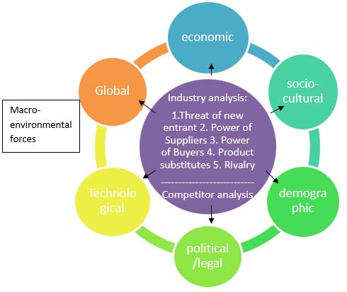
FINDINGS OF ENVIRONMENTAL ANALYSIS
Need to implement new technologies that could use plastic production fashion products that would evaluate potentiality of Very in retail segment
Positive approach is required to gain market share by creating brand image where reusing of plastic need to be fast approach for operational benefit (Awoyera and Adesina, 2020)
Develop impact on environment Very would lead to adapt environment friendly products for production and distribution
Operational activities would be effective to gain profitability by operational activities for financial benefits in next few years
Notes:
Environment analysis of Very has indicated current issues regarding use of plastic reduce the brand image of this organisation among customers. Also, the competitive advantage of this company has failed due to legal issues regarding use of plastic production and distribution. Organisational capacity product more production has been disturbed by plastic regarding issues where reduced cost in production facilities would be available by using process plastic. Impact on the environment by using plastic creates a negative influence on society. Due to that reason they need to adopt new technologies to either dispose of plastic or reuse plastic for production.

Slide 9
REFERENCE LIST
Flury, M. and Narayan, R., 2021. Biodegradable plastic as an integral part of the solution to plastic waste pollution of the environment. Current Opinion in Green and Sustainable Chemistry, 30, p.100490.
Van Rensburg, M.L., S'phumelele, L.N. and Dube, T., 2020. The ‘plastic waste era’; social perceptions towards single-use plastic consumption and impacts on the marine environment in Durban, South Africa. Applied Geography, 114, p.102132.
Serrano-Ruiz, H., Martin-Closas, L. and Pelacho, A.M., 2021. Biodegradable plastic mulches: Impact on the agricultural biotic environment. Science of The Total Environment, 750, p.141228.
Napper, I.E. and Thompson, R.C., 2020. Plastic debris in the marine environment: history and future challenges. Global Challenges, 4(6), p.1900081.
Zhang, E.J., Aitchison, L.P., Phillips, N., Shaban, R.Z. and Kam, A.W., 2021. Protecting the environment from plastic PPE. bmj, 372.
Awoyera, P.O. and Adesina, A., 2020. Plastic wastes to construction products: Status, limitations and future perspective. Case Studies in Construction Materials, 12, p.e00330.
Awoyera, P.O. and Adesina, A., 2020. Plastic wastes to construction products: Status, limitations and future perspective. Case Studies in Construction Materials, 12, p.e00330.
Qi, R., Jones, D.L., Li, Z., Liu, Q. and Yan, C., 2020. Behavior of microplastics and plastic film residues in the soil environment: A critical review. Science of the Total Environment, 703, p.134722.
very.co.uk, 2022, Company profile of very, Accessed at; https://www.very.co.uk/ [Accessed on: 4th November, 2022

Slide 10
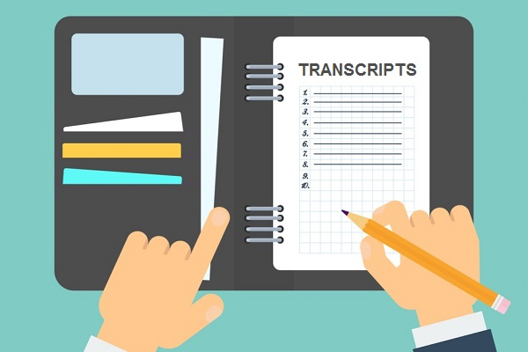
PRESENTATION TRANSCRIPT 1
Revenue and customer growth percentage regarding information published organisational potentiality for future growth
Objectives of Very established managerial aspect gain more acceptance among customers that going to improvise total and earnings of this organisation
Customer growth percentage established possibilities of Business expansion by adopting new technologies
Reducing use of plastic manager going to adapt recycling process to use plaster for productivity, which provide positive note toward customers
Vision and objectives of Very present it continuous population of the business adopting new fashion trend
Notes:
Using plastic in operational activity regarding issues and possible outcomes to mitigate this crisis has been evaluated by analysing the condition of retail company Very. Additionally company overview and present growth percentage Customer regarding information and revenue. Utilisation of financial resources would be effective to gain financial benefit through business operation using a plastic, creating a lack of operational activities in this organisation. Also, the brand image of this organisation has been disturbed by overuse of plastic that could be changed in next financial objectives. Organisation vision has established future business prospects and activities as per requirement that is interesting in reducing use of plastic by adopting average cost management policies.

Slide 11
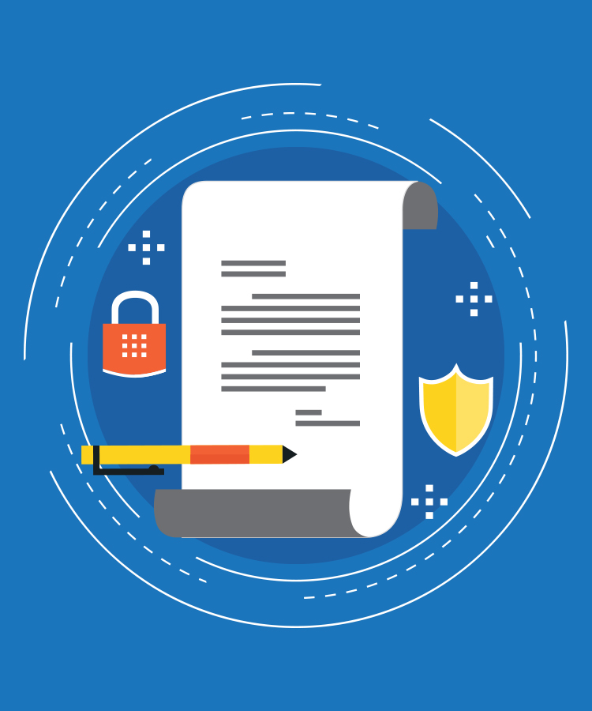
Presentation Transcript 2
Identification of different prospect of Very to present legal and brand image creation regarding challenges
Objectives of the management employees revenue what are the possibilities would be implemented to reduce use of plastics
Delivering positive approach biography on new technology Very would be able to create positive image customers
Environment analysis has presented positive prospect of business growth by adopting less consumption of plastic regarding activities that has explored operational development in next few years
Notes:
PESTLE Analysis of Very is going to explode with different aspects oriented with this organisation that also present an environmental aspect regarding use of plastic production and marketing. Fashion Retail Industry of UK adopting new technologies to avoid use of plastic and gain customer trust about environment development. Fashion organisations are also trying to establish a positive image among customers adopting new technologies regarding reuse of plastics or recycling of plastics to make fashionable products. Additional information has been conducted regarding findings of environment analysis that present the organisation and face different challenges due to excessive use of plastic.

Slide 12


